Slide 1
Benefits and challenges with the Royal Academy of
Engineering visiting professors programme
Dr Tom Prickett MBCS CITP SFHEA, Northumbria University
Dr Phil Brooke CEng FBCS CITP,
Green Pike Ltd / Northumbria University
Dr Paul Johnson, PJEC Ltd / Arup / Newcastle University
Dr Jaime Amezage, Newcastle University

Slide 2
Background
Royal Academy for Engineering (RAEng) is
  “a charity that harnesses the power of engineering to build a sustainable society and an inclusive economy that works for everyone.” (https://www.raeng.org.uk/ )
Amongst many activities provide several grants and prizes
A number are focused upon
  Academia into Industry
  Industry into Academia

Slide 3
RAEng Visiting Professors Scheme - What is it?
Industry into academia initiative
Utilises the experience of Visiting Professors who are
Industrialists, entrepreneurs, consultants or innovators
Strengthens partnerships with industry
To promote employability

Slide 4
Visiting Professor scheme in more detail
The award supports the attendance of a Visiting professor at the hosting university for at least 12 days a year
Maximum value
£10000 a year
£30000 over 3 years
Scheme promotes diversity from under-represented groups by a range of dimensions
Covers all engineer disciplines
Vast majority of Visiting Professors demonstrate professional registration and membership with many being Engineering Fellows.

Slide 5
Northumbria Scheme
Academic Champion
  Tom Prickett
Visiting Professor
  Phil Brooke

Slide 6
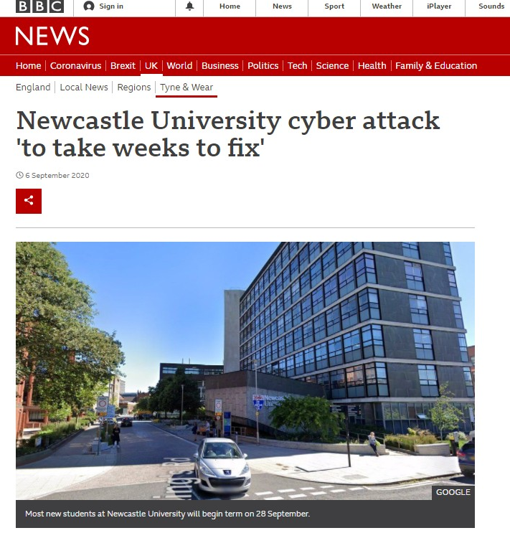
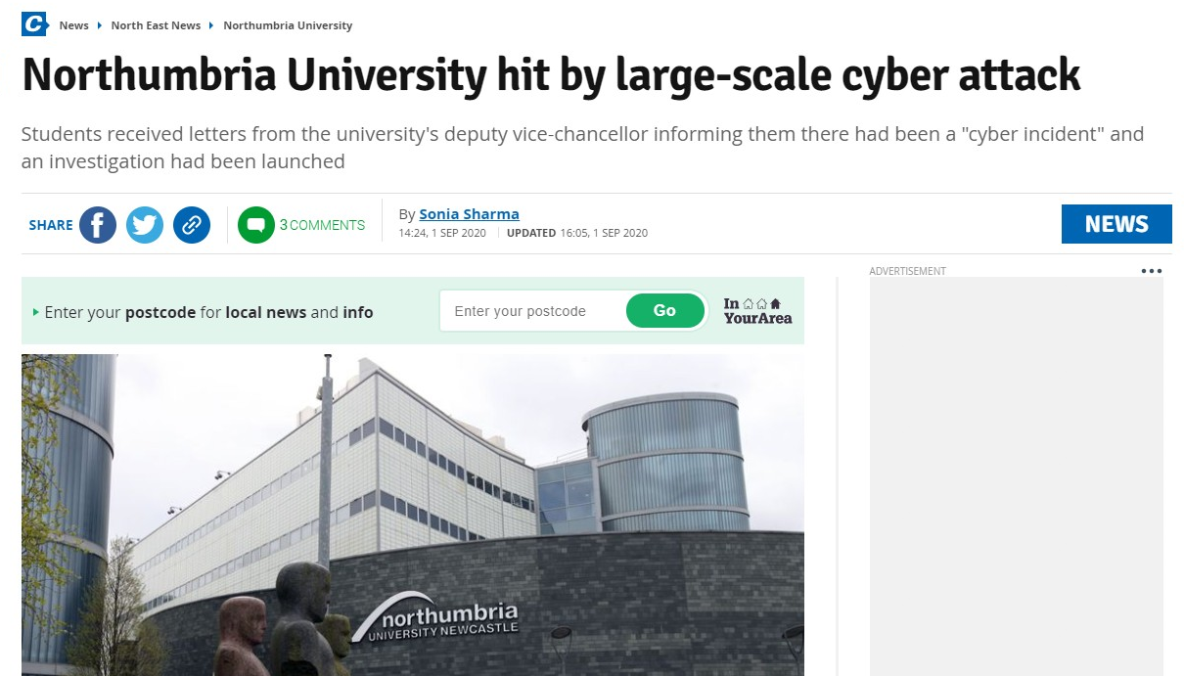
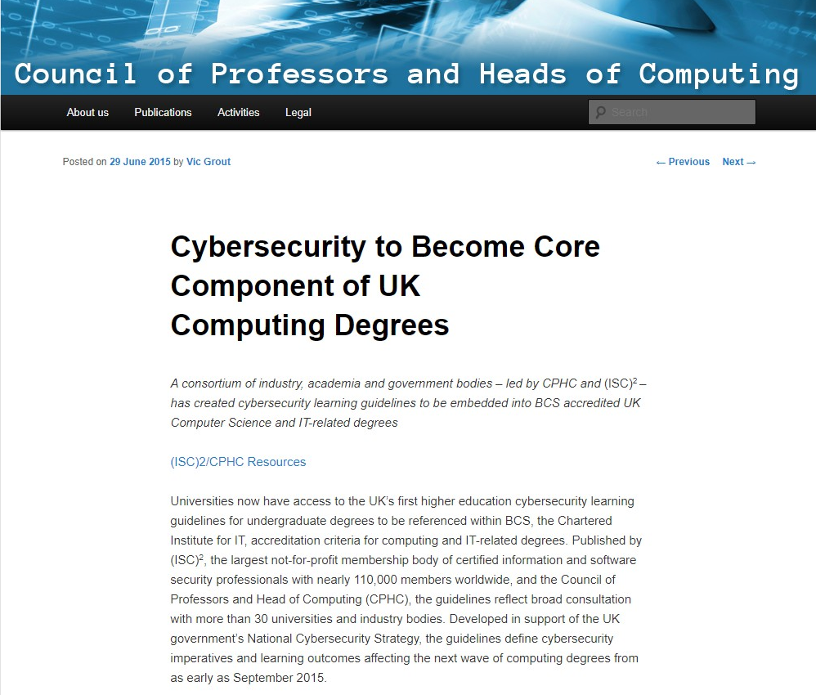
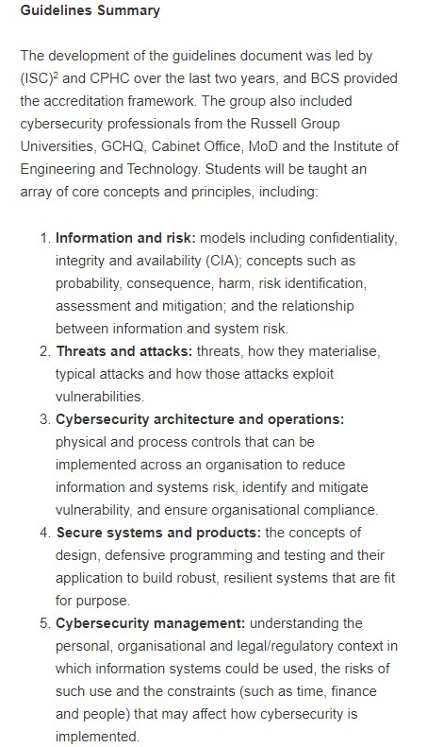
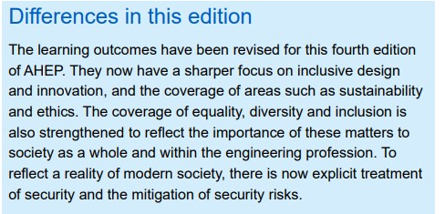
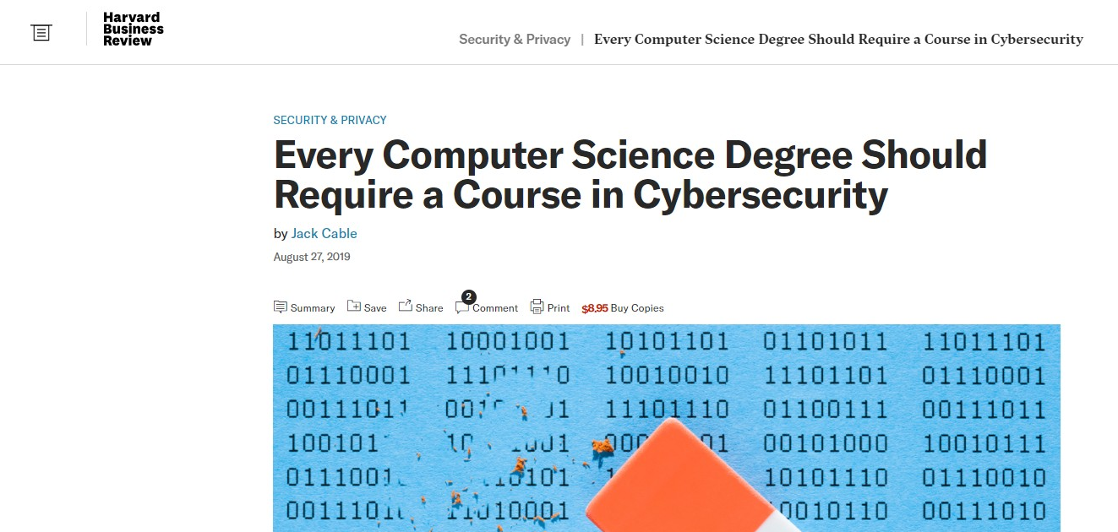
”UN Sustainability Goal 9: Build resilient infrastructure, promote sustainable industrialization and foster innovation” [7]
Notes:
We recognise there is pressure from the media and wider security for us to address security within our programmes. We know the council of professors and heads of computing, together with the related professional bodies and government departments have a agreed an expected curriculum. All BCS accredited degrees will now teach and assesses this curriculum or have an action plan in place to do so. We also know with the Engineering Council 4th edition of the Accreditation of Higher Eduction Programmes there is now an expectation for coverage of security in engineering programmes too. We also know that UN Sustainability Goal 9: Build resilient infrastructure, promote sustainable industrialization and foster innovation. Security is hence clearly part of sustainability. So for these and a whole range of other reasons we need to address security within our programmes and modules. Tt is one thing to teach security however it is another to teach it well.

Slide 7
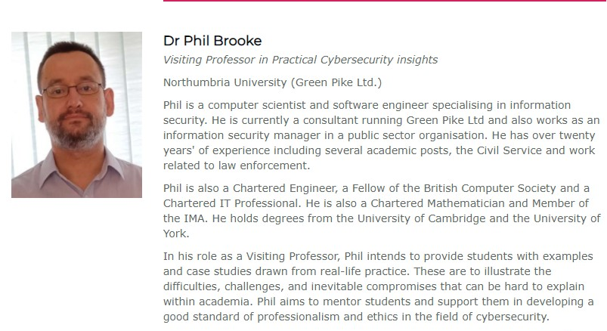
Northumbria Visiting Professor

Slide 8
Teaching Innovations – including security in general CS – Embedding across Curricula – Lead by visiting Industrial Professor

Slide 9

Information
Security
https://unsplash.com/photos/wJ7atxTNeQE

Slide 10
Successes
Linking real-world examples and their lessons to underpinning academic information security concepts. Demonstrating the applicability of content delivered in modules
Encouraging and mentoring individuals and small groups, particularly in small-group teaching where wider conversations are feasible
Adding industrial/public-sector stories, guidance, … into group project work. Particularly valuable around the realities of group work, limited resources and interpersonal relationships
Not just about information security – wider applicability of industrial fellows where a different background reinforces the academic delivery

Slide 11
Challenges
(as for so many others...) COVID and the need for remote delivery
This has significantly reduced interactions, and we assert that much value is to be found in "side" conversations that occur less often in remote delivery. Particularly hits lab / small group teaching
Delivering pre-prepared lectures – time-consuming to prepare and although useful to watch at a student's convenience removes all interactivity
Coordination 1: The industrial fellow can normally schedule time to suit Northumbria's timetables... but not always
Coordination 2: For the best impact to the students, need to schedule at a "good" place in existing academic content to properly reinforce and support it

Slide 12
Newcastle Scheme
Academic Champion
  Jaime Amezage
Visiting Professor
  Paul Johnson

Slide 13
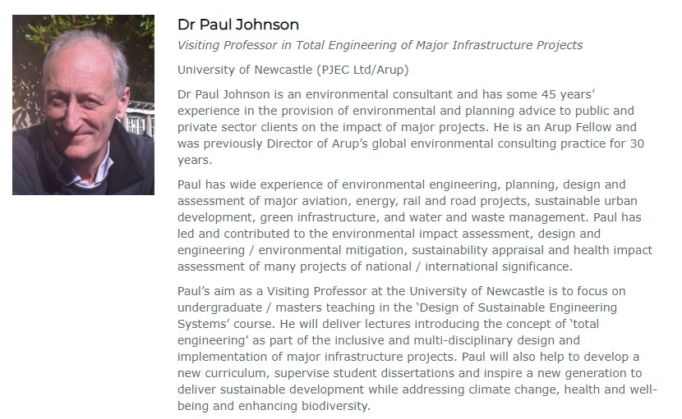
Newcastle Visiting Professor

Slide 14
Successes
Introducing concept of ‘total design’ / ‘total engineering’ with regard to major infrastructure and development projects into undergraduate and MEng teaching resources
Using 40+ years of industry experience to introduce real life project challenges and opportunities into academic process
Enthusing students through teaching, mentoring and course work to incorporate holistic multi-disciplinary inputs (involving environment, biodiversity, water, climate, heritage, social, economic etc) into concept development, optioneering, detailed design and construction
Undergrad coursework has a foundation in real world – eg 15 teams of 12 students working on a project to define the route and design of new 40km high speed railway in the north-east of England

Slide 15
Challenges
Covid-19 has removed the valuable face to face element but the new challenge of using packages such as Zoom, Teams and Flipgrid has allowed considerable innovative interaction, albeit remotely
Newcastle School of Engineering curriculum is changing to a common year 1 for all engineering students. Not easy to find time for ‘non-core’ topics such as sustainability, climate and environment other than at a very high and brief level of introduction
Refocusing the introduction of holistic integrated design to 2nd and 3rd year student courses, practical projects and MEng dissertation mentoring

Slide 16
What next
Northumbria Scheme is in 2nd year of operation. Next year will be last year
In addition to planned contributions to curricula and assessment design, teaching and mentoring of learners
  Produced reusable video-based resources
  Discussions / training of academic colleagues
  Related publications (https://doi.ieeecomputersociety.org/10.1109/FIE44824.2020.9274033 , https://www.ease.ws/ )
Need to plan for sustainability and evaluation of impact

Slide 17

Any Questions?

